Slide 1


Volleyball Training Manager
Design and Plan
Team Spike
By: Nj , Halo , Simba , Anton, Lara

Slide 2

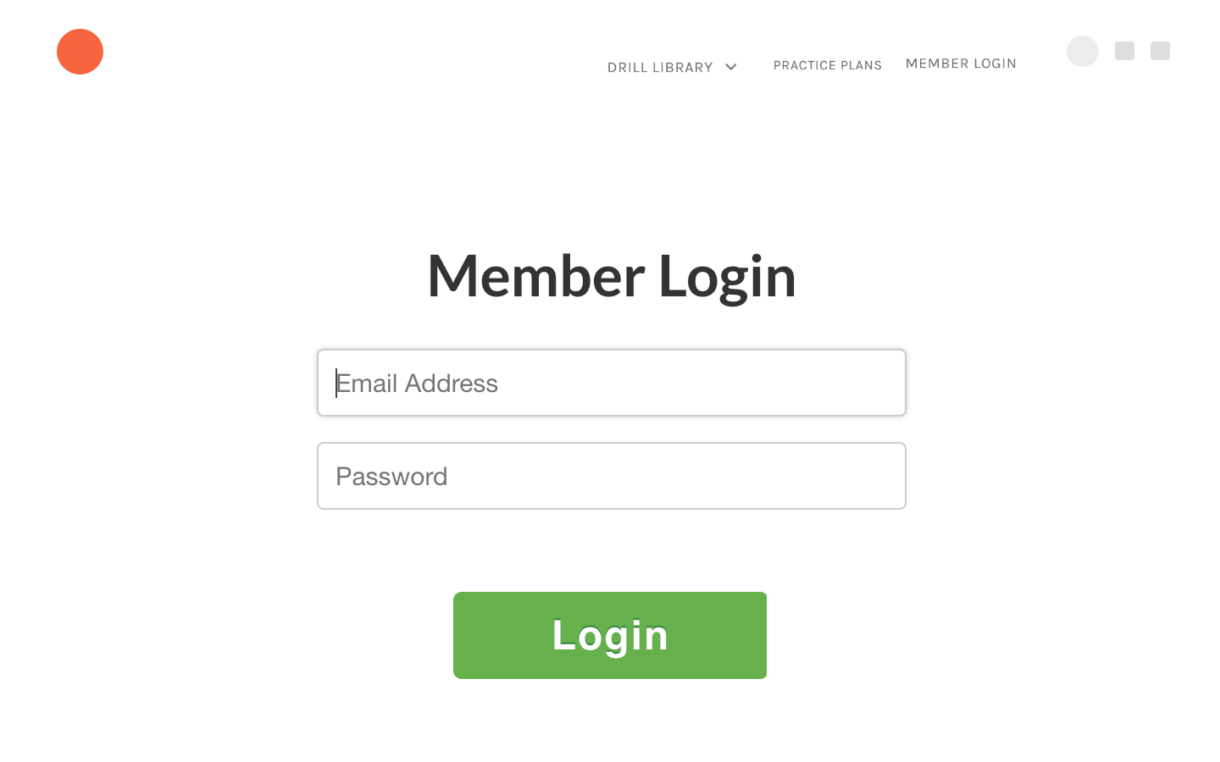
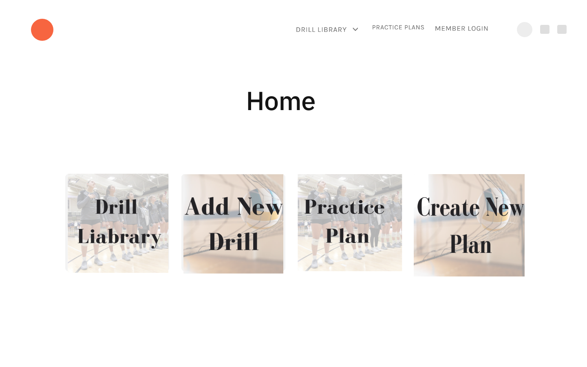
Overview GUI
Information on Log in page and Home page

Slide 3
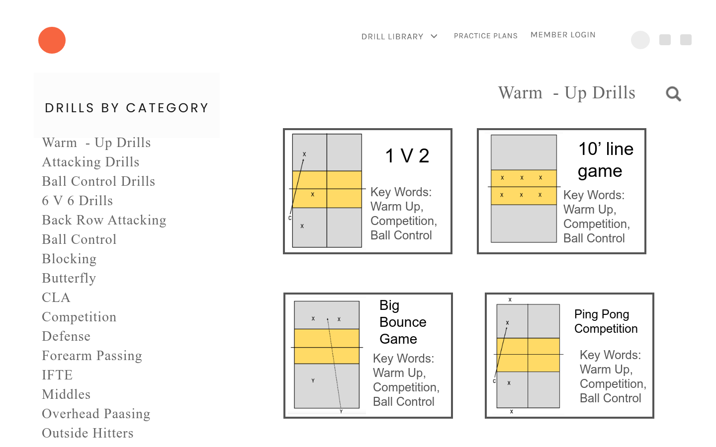
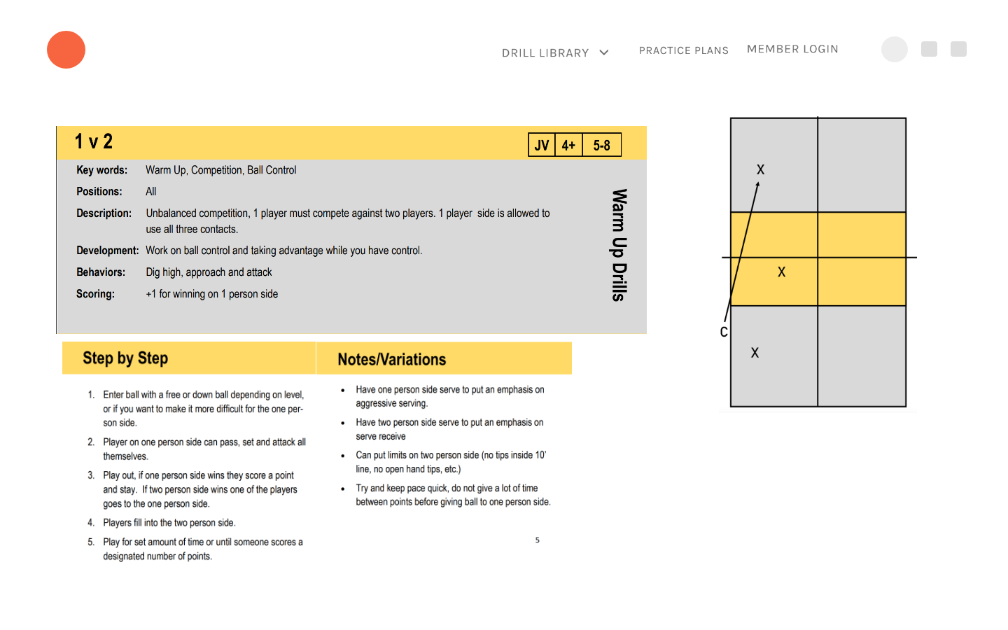
Overview GUI
Information on adding drills and viewing drill information

Slide 4
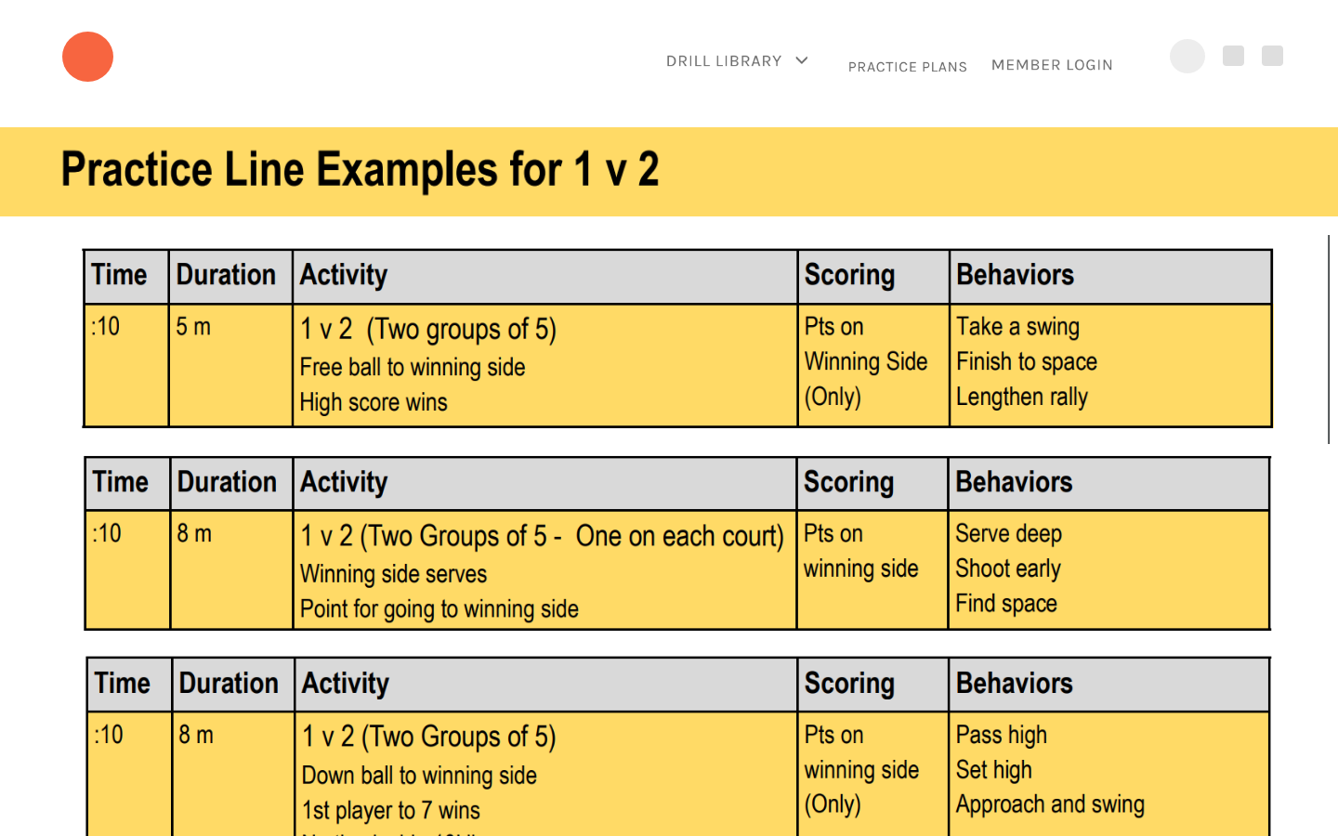
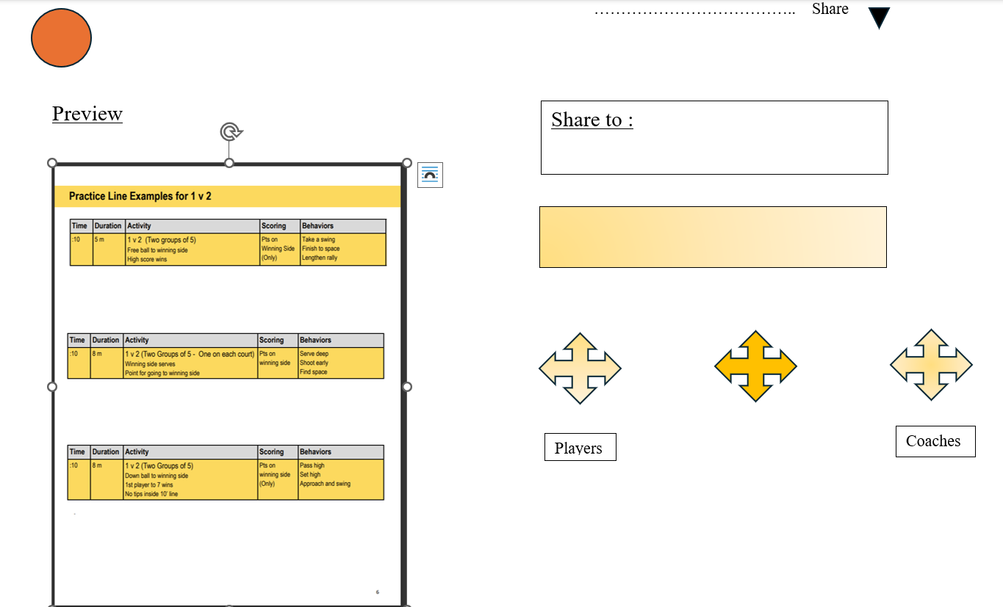
Overview GUI
The final thing as a practice line and the share page

Slide 5
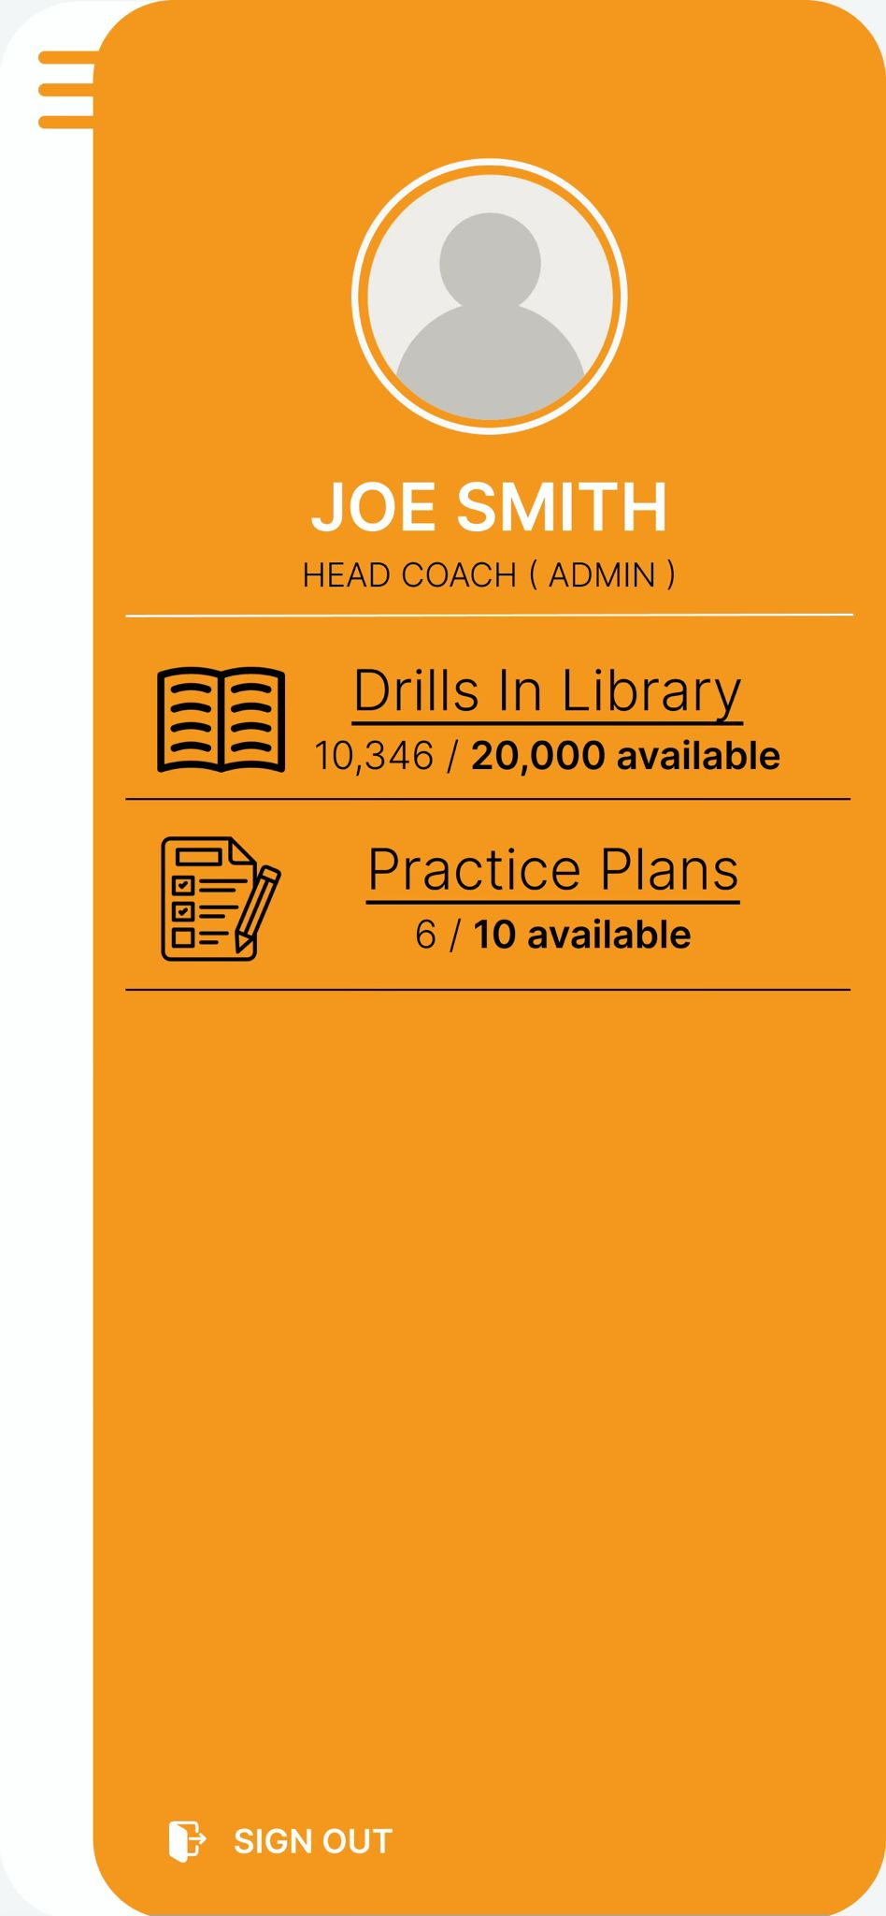
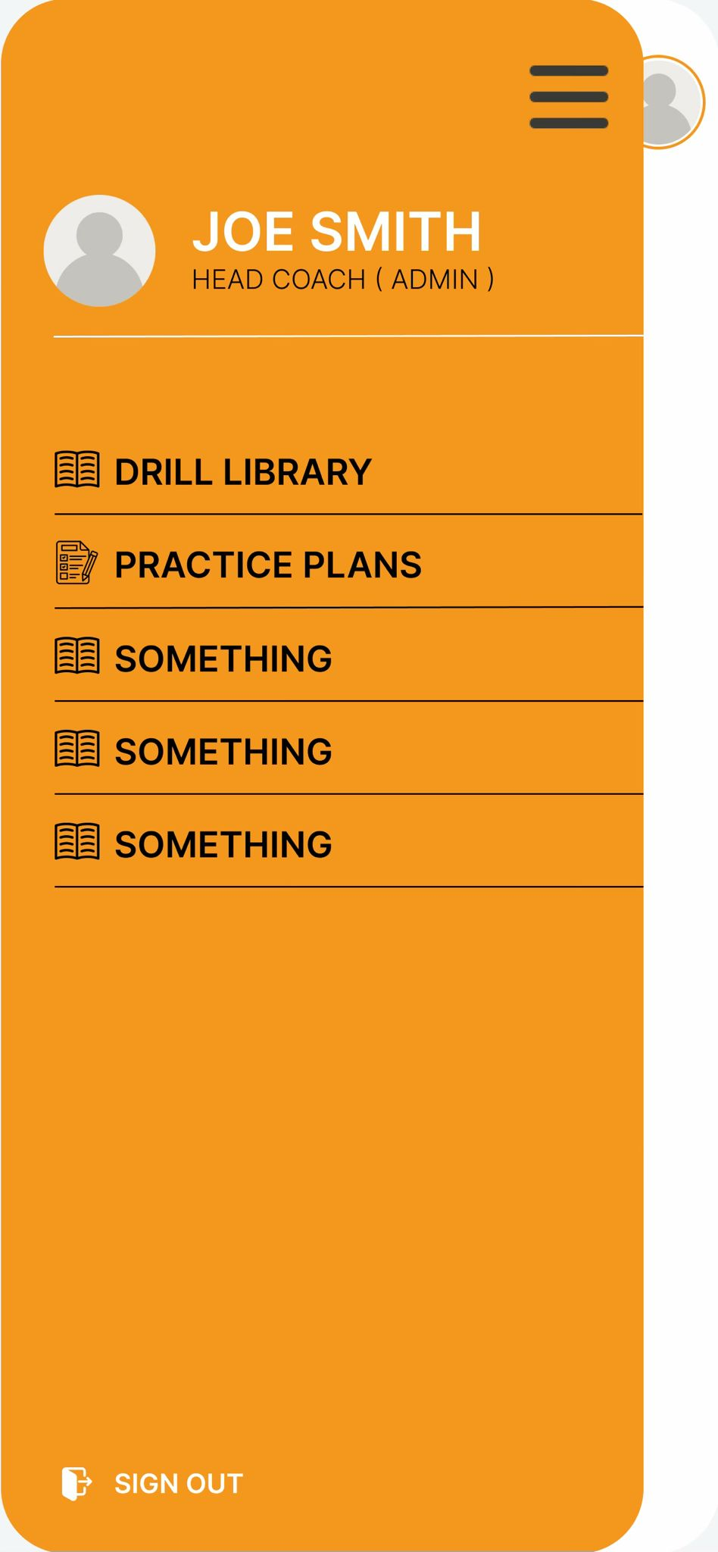
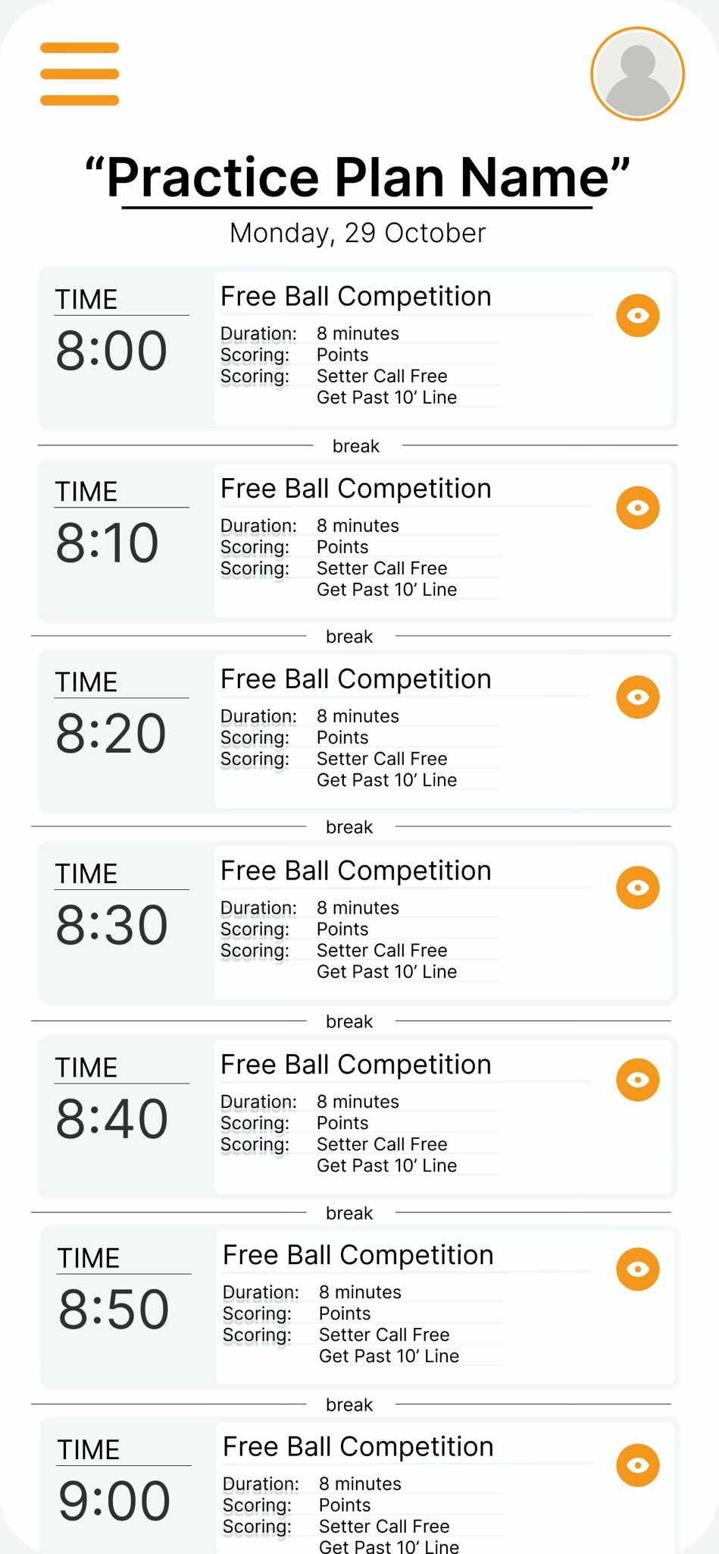

Mobile wireframes
Cover the view only for players and setup on the mobile phones

Slide 6
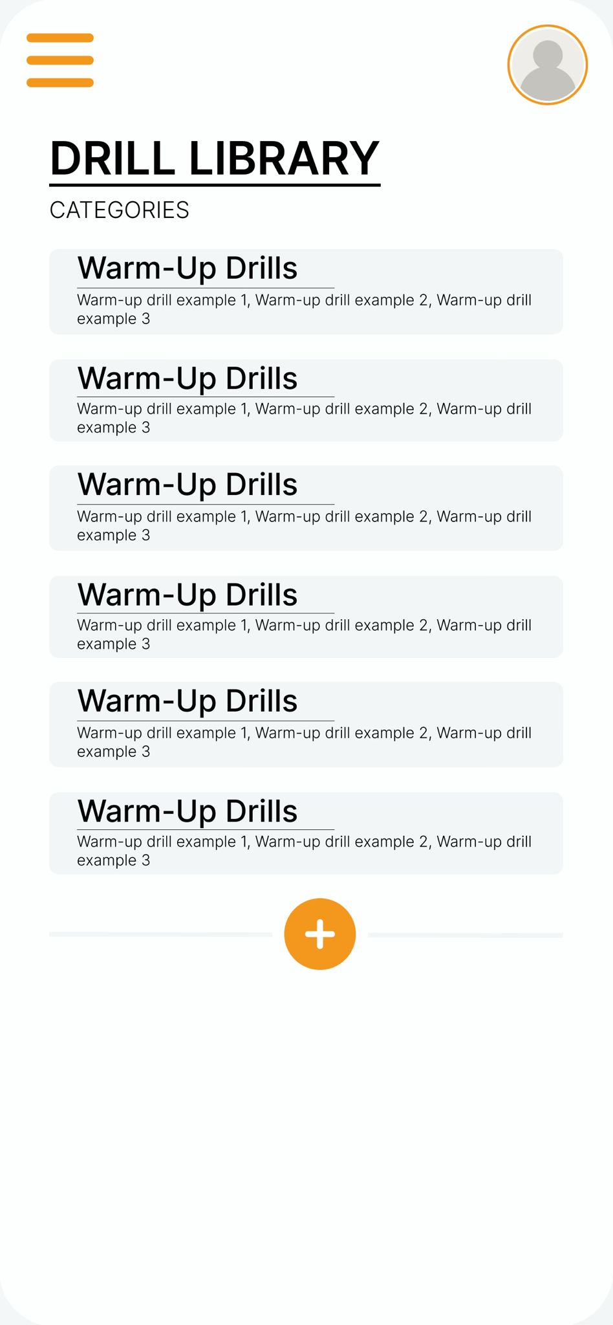
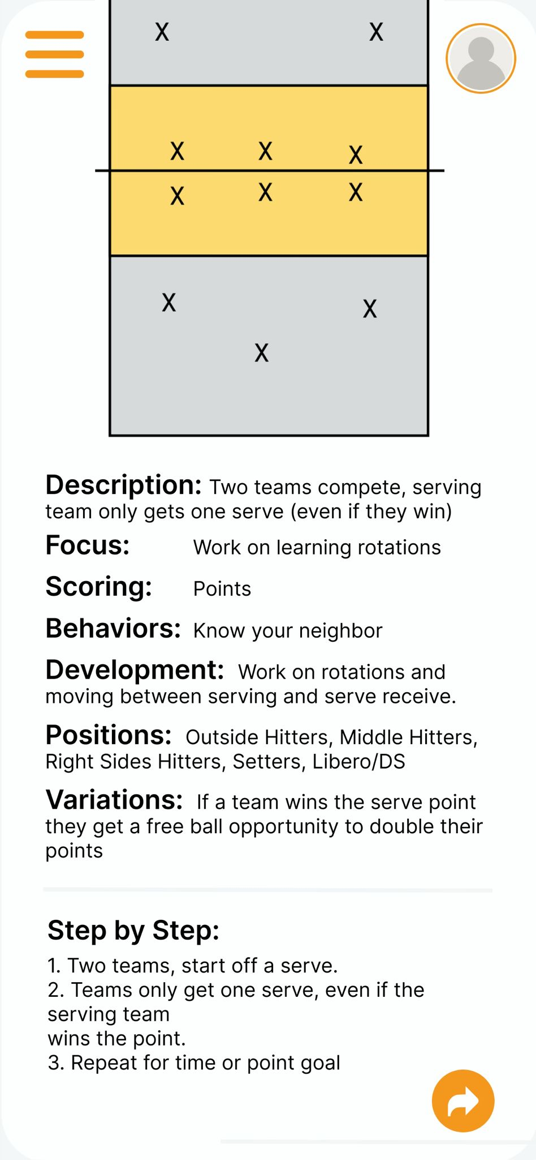
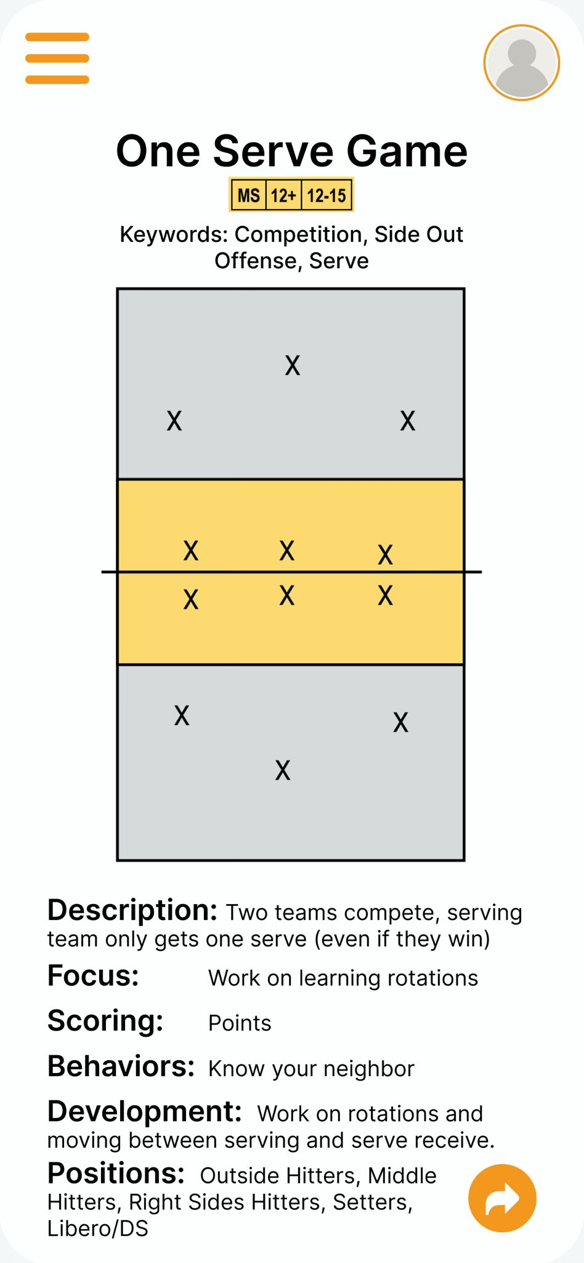
Mobile wireframes
Cover the view only for players and setup on the mobile phones

Slide 7
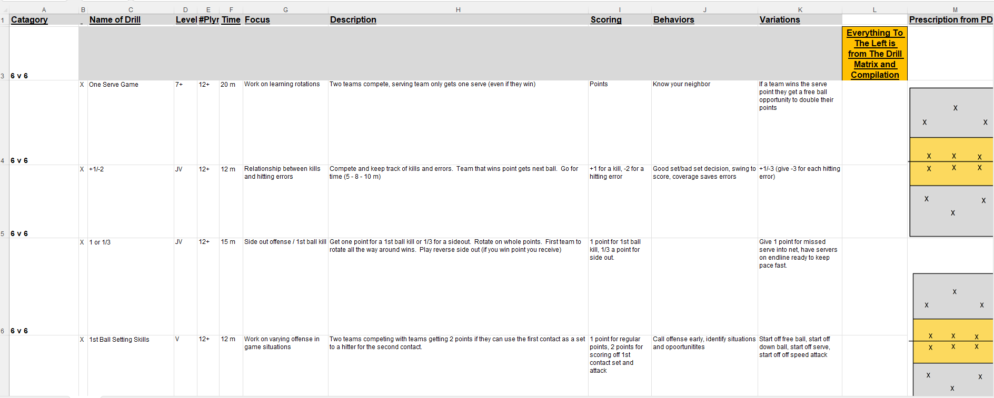
Database Setup
Data base consists of excel and pdf files , and information on Retool

Slide 8
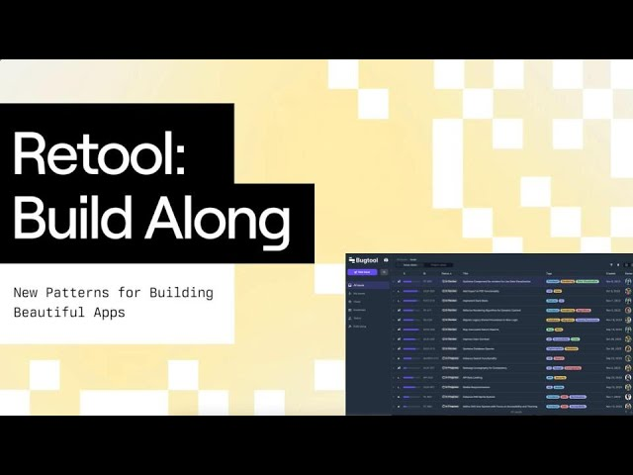
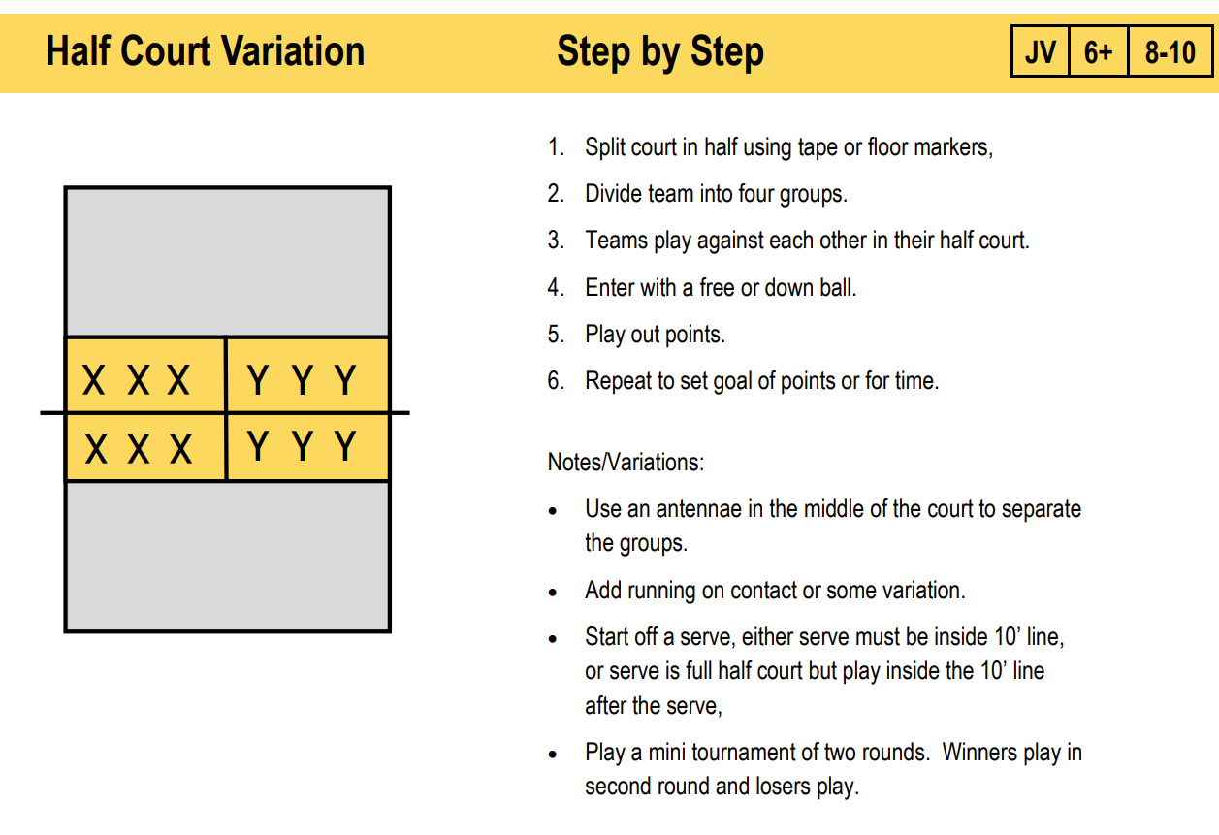
Database
Few details on retool and how we use it

Slide 9




Architecture
Mobile device
Laptop
Online website
Internet connection

Slide 10
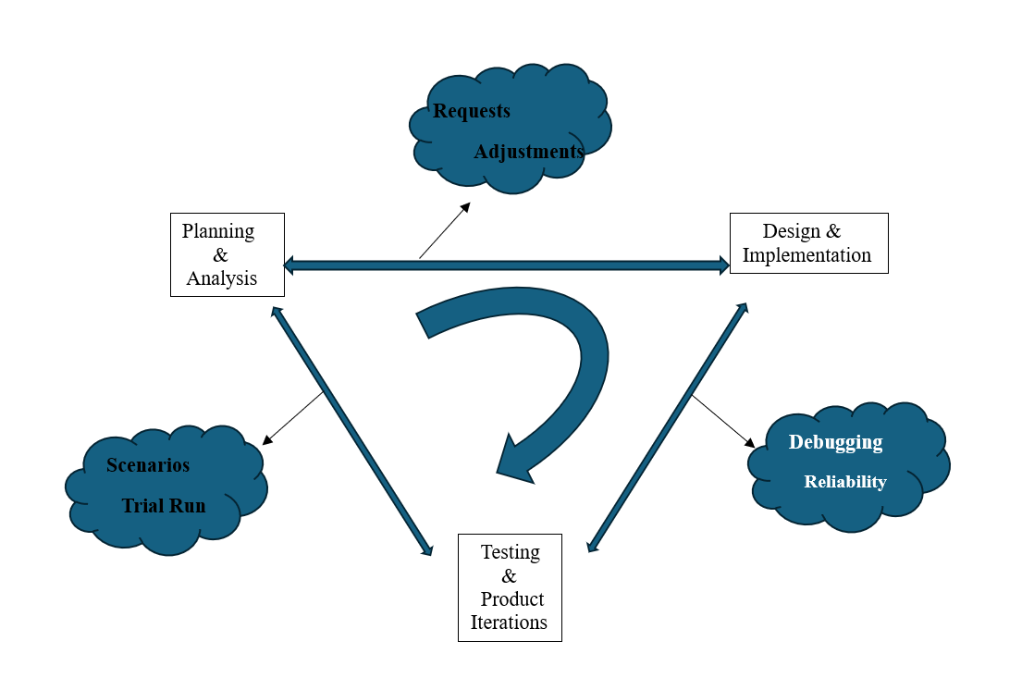
Lifecyle
Agile Lifecyle reference of a triangle

Slide 11
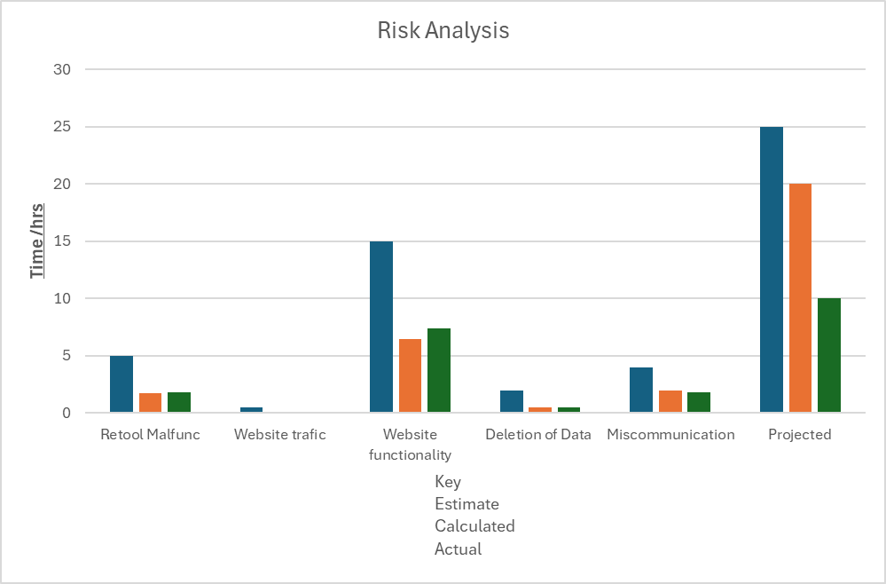
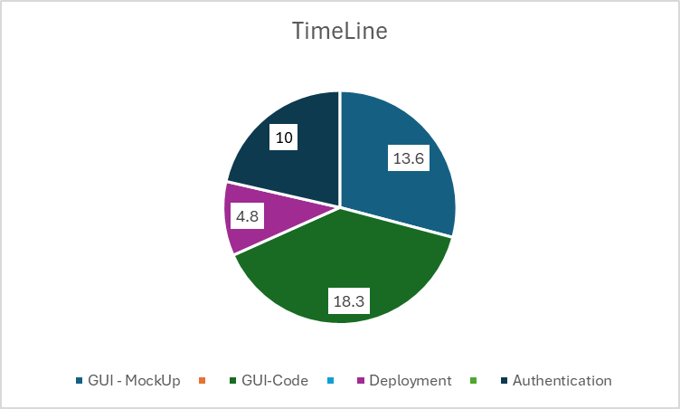
TimeLine and Risk analysis
Using Excel and charts for analysis

Slide 12

Resolving Conflict
Remember level of importance (Grade)
Team Roles
Designer -Anton
Coder -Nj
Tester -Lara
Documenter -Halo
Scrum Leader -Simba

Slide 13

Thank
You

